Slide 1
Wireframe Your Way to Visualizations that Wow
Wireframing & Design Thinking
Shreya Arya @datavizfairy | shreya.arya@theinformationlab.co.uk She/Her

Slide 2
Notes:
MANDATORY: INSERT AT START OF PRESENTATION - AFTER TITLE SLIDE AND BEFORE SPEAKER SLIDE
Talk Track:
I want to first give a quick reminder that Salesforce is a publicly traded company, and customers should base their purchasing decisions on products and services that are currently available.

Slide 3
Thank You
Notes:
Thank you so much joining me today Datafam, as I discuss the power of Wireframing and Design Thinking.

Slide 4
01 | Setting the scene…
02 | Who’s the Expert?
03 | The power of Design Thinking
04 | Benefits of Wireframing
05 | Where to Wireframe?
06 | 6 Tips
Notes:
For today’s talk, I’ll start by setting the scene.
Then, we’ll move into an exercise called ‘Who’s the Expert?’
After that, we’ll explore the power of design thinking and wireframing together.
Finally, I’ll introduce three tools you can use for wireframing, and share some helpful tips to get you going.

Slide 5
Shreya Arya
Tableau/Alteryx Consultant
The Information Lab
Notes:
Before we dive in, I wanted to quickly introduce myself. Hi, I’m Shreya. I’m a Tableau/Alteryx Consultant at the Information Lab.

Slide 6
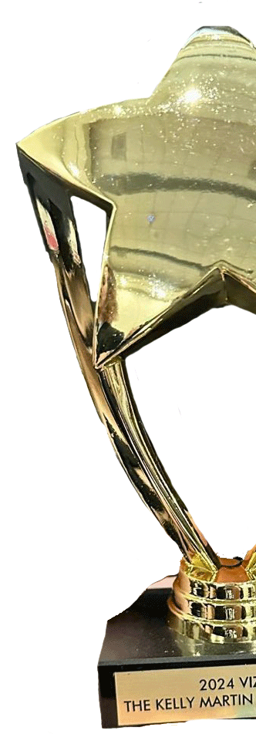
About Me
• | Tableau Public Ambassador Sept 2024
• | X8 Viz of the Day’s Tableau Public
• | X1 Vizzie Award Winner The Kelly Martin Best Designer ‘24
• | B2VB Co-lead Tableau Community Project
 | 2 Years Since I started my Tableau Journey…
Shreya Arya – Tableau Public Profile
datavizfairy.co.uk
Notes:
Tableau Public Ambassador
I’m also a Tableau Public Ambassador – I love exploring the creative powers of Tableau in my visualisations.
Viz of the Days + Vizzie Award Winner
I’ve received x8 Viz of the Day’s on Tableau Public, and at this years Tableau Conference in San Diego, I won the Vizzie award for The Kelly Martin Best Designer – and it meant so much for my work to be recognised in this way!
B2VB Co-lead
I also co-lead the Tableau community project, Back 2 Viz Basics, with Eric Balash and Elisa Davis. With our bi-weekly challenges, we help users build essential data viz skills. It’s really rewarding to support new users as they learn Tableau.
2 years
Speaking of which, I started my Tableau Journey around 2 years ago, and it’s been the most incredible experience to be able to grow my skills within the DataFam. I’m really grateful I get to do this every day.

Slide 7
Setting the Scene…
Notes:
Now that you know a bit about me, let’s set the scene...

Slide 8
Every Business has its goals...
Increasing Sales
Improving Customer Retention
Reducing Operational Costs
How can they achieve them?
Notes:
Every business has its goals – whether that’s Increasing sales, Improving Customer Retention or Reducing Operational Costs.
But how can they achieve those goals?

Slide 9
By taking targeted, strategic actions...
Problem
Solution
Implement
How do you know which actions will make the most impact?
“
Data
.
Notes:
Businesses need to take targeted, strategic actions that lead to meaningful outcomes.
But how do you know which actions will have the most impact? This is important because resources are limited, and no one wants to waste time or effort on the wrong priorities.
Well, that’s where Data comes in!

Slide 10
Data
Helps us to identify the problem.
Customers leaving?
Poor service times.
Revenue dropping?
Specific product.
DATA
Notes:
Data helps us identify the real problem.
For example, if revenue is dropping, data might show us it’s because of a specific product. If customers are leaving, it could point to long service times.
By understanding the problem through data, we can find the right solution and take meaningful action.
But here’s the thing—raw data can be overwhelming and hard to interpret. That’s why dashboards are so powerful. They turn that raw data into clear, actionable insights, helping us quickly spot issues and make informed decisions.

Slide 11
Who’s the expert?
Question
Notes:
This brings us onto our next section: Who’s the expert?

Slide 12
Who’s the expert?
Data Analyst
Stakeholder
Notes:
Here I have two candidates: A data analyst and a Stakeholder. Who do we think the expert is?
“If you feel the Data Analyst is the expert, raise your hand”
“If you feel the Stakeholder is the expert, raise your hand”
“If you feel it’s both…”
“If you feel it’s neither…”

Slide 13
Answer: Both!
Data Analyst
Stakeholder
Notes:
Answer: It’s both!
Let’s look into this further.

Slide 14
An expert of data…
+ | Experienced with Business Intelligence tools.
+ | Deliver insights quickly
+ | Visualisation best practices
– | Business Goals and Objectives
– | Industry specific knowledge
Data Analyst
Notes:
The data analyst is an expert of data.
They know how to use BI tools, follow data visualisation best practices, and deliver insights quickly. However, they may not always have a deep understanding of the business goals or industry context.

Slide 15
An expert of the industry…
+ | Strong understanding of the Business / Industry.
+ | Goals and Objectives
+ | Decision making capability
– | How to pull insight from the data
Stakeholder
Notes:
The stakeholder is an expert in their industry or business unit. They know the company’s goals, sector challenges, and necessary strategic decisions but may lack the technical skills to extract insights from the data on their own.

Slide 16
Data-informed decisions
drive business growth
Notes:
That’s why collaboration is so powerful.
When the data analyst’s insights combine with the stakeholder’s business knowledge, they can make data-driven decisions that drive real growth. Together, they turn data into actionable solutions that move the organisation forward.
The key is finding a way to collaborate effectively and turn their efforts into solutions that work. And that’s where Design Thinking comes in.

Slide 17
The power of Design Thinking
A collaborative process.

Slide 18
Design Thinking
What is
?
Notes:
So what is Design Thinking?

Slide 19
Design Thinking
A collaborative, problem-solving approach…
that focuses on understanding users' needs and
creating innovative solutions.
Notes:
Design Thinking is a collaborative, problem-solving approach that focuses on understanding users’ needs and creating innovative solutions.

Slide 20
Design Thinking
Five Key Stages:
Empathise
Define
Ideate
Prototype
Test
Notes:
This approach follows five key stages: Empathise, Define, Ideate, Prototype, and Test. Each stage plays an essential role in making sure what we create truly aligns with the end-user’s needs. Let’s dive into each stage in more detail...

Slide 21
Design Thinking
Five Key Stages:
Empathise
Define
Ideate
Prototype
Test
What are their pain points?
Notes:
Empathise
Empathise means truly understanding your users. Talk to them, observe how they work, and learn about their challenges and needs. The better you understand their pain points, the more tailored and effective your solution will be.

Slide 22
Design Thinking
Five Key Stages:
Empathise
Define
Ideate
Prototype
Test
What’s the main problem to solve?
Notes:
Define
Next, Define the problem. After understanding your users, it’s important to pinpoint the main issue you’re addressing. A well-defined problem keeps your solution focused and ensures it directly meets their needs.

Slide 23
Design Thinking
Five Key Stages:
Empathise
Define
Ideate
Prototype
Test
Which insights should stand out?
Notes:
Ideate
After defining the problem, move into Ideate. Here, you’ll explore the data to identify key insights for your users. This stage is about deciding how best to present those insights, including which chart types or interactions will highlight the most important metrics.

Slide 24
Design Thinking
Five Key Stages:
Empathise
Define
Ideate
Prototype
Test
How will the layout and flow work?
Notes:
In Prototype, you create a wireframe to map out key metrics and ensure a logical information flow. You’ll plan user interactions like filters and drill-downs, testing the structure and usability. This wireframe provides early feedback, allowing you to refine your design before full development.

Slide 25
Design Thinking
Five Key Stages:
Empathise
Define
Ideate
Prototype
Test
Does it meet their needs?
Notes:
Test
Finally, we move to Test. At this stage, you share the wireframe or prototype with stakeholders to gather feedback. It’s a chance to check if the key metrics, functionality, and overall approach meet their needs. This feedback helps you make any necessary adjustments before moving forward.

Slide 26
Design Thinking
Example
Imagine you’ve been asked to create a dashboard for your local hospital.
How can you make the most impact?
Notes:
Let’s go through an example of how we’d apply this design thinking process together.
Imagine you’ve been asked to create a dashboard for your local hospital. You have complete freedom, you can create your dashboard on any topic you’d like…
But how can you make the most impact and provide value?

Slide 27
Design Thinking
Imagine you’ve been asked to create a dashboard for your local hospital.
Empathise
Understand the user and the problems they’re facing…
Staffing and Resource
Allocation
Patient Flow
and Satisfaction
Bed Management
Notes:
We start by empathising—having conversations with hospital staff and management to understand their challenges.
For example, might they be struggling with staffing levels, patient flow, or bed availability?
Understanding their specific pain points helps us focus on creating solutions that genuinely meet their needs.

Slide 28
Design Thinking
Imagine you’ve been asked to create a dashboard for your local hospital.
Define
User Story
What problem are you targeting?
As a [Role],
I want to [Objective]
so that I can [Desired Action].
Patient Flow
and Satisfaction
ER Department
Notes:
Now, we’re in the Define stage, where we choose a specific problem to focus on. In this case, we might decide that Patient Flow and Satisfaction, especially in the ER department, is a key priority.
To stay focused, I like to create a user story. A user story frames the objective from the stakeholder’s perspective, helping us stay aligned with their needs throughout the process.
Using the template on the right, we’d write something like: ‘As a [Role], I want to [Objective] so that I can [Desired Action].’ This keeps us clear on what they’re aiming to achieve.

Slide 29
Design Thinking
Imagine you’ve been asked to create a dashboard for your local hospital.
Define
User Story
What problem are you targeting?
As an ER Manager, I want to monitor patient wait times and admission rates, so that I can make informed decisions to keep the ER efficient and provide timely care to patients.
Patient Flow
and Satisfaction
ER Department
Notes:
So for this particular example, our user story might read:
As an ER Manager, I want to monitor patient wait times and admission rates, so that I can make informed decisions to keep the ER efficient and provide timely care to patients.

Slide 30
Design Thinking
Imagine you’re creating a dashboard for your local hospital.
Ideate
Which metrics or charts could help?
Patient Visits
Admission Rates
Wait Times
Trends - Line Chart? Area Chart?
Satisfaction Scores
Percentages?
Notes:
Now that you’ve put yourself in your stakeholder’s shoes and understand what they want from this dashboard, you can start brainstorming the key metrics to focus on. Think about which metrics are most important and which charts, will best bring this information to life.

Slide 31
Design Thinking
Imagine you’re creating a dashboard for your local hospital.
Prototype
Find the best layout and way to organise key metrics.
Hospital E.R. Dashboard
Notes:
Once you’ve identified the data and key metrics, you can sketch a layout to organise them effectively. This prototype gives you a sense of how the information will flow, ensuring everything is arranged clearly and makes an impact.

Slide 32
Design Thinking
Imagine you’re creating a dashboard for your local hospital.
Test
Present to Stakeholders. Be open to feedback!
e.g. they may not like a visual, prefer something else?
Remember, you are designing for their use and adoption.
Align to their needs.
Hospital E.R. Dashboard
Notes:
Finally, I’ll set up a meeting with my stakeholders to share the sketch and gather their feedback. They can let me know if the metrics and charts I’ve chosen are useful, suggest alternatives, and offer any other ideas to refine the dashboard before building it in Tableau.
It’s essential to be open to their feedback, as they’ll be the ones using this dashboard to make informed decisions. With their input, we can make adjustments and strengthen the plan to ensure it truly aligns with their needs.

Slide 33
Design Thinking
Imagine you’re creating a dashboard for your local hospital.
Data Insights = Solution
Notes:
By following these five stages, you’ve turned a specific problem into a solution-driven product—a dashboard that’s impactful and aligned with their needs. If you want to address another problem, you can simply go through the process again.

Slide 34
Design Thinking
Five Key Stages:
Empathise
Define
Ideate
Prototype
Test
An Agile process.
Notes:
You might notice these stages aren’t numbered—that’s because design thinking is an agile process. It’s not always linear; you may need to revisit earlier stages. For example, after testing, you might realise the problem needs redefining or new ideas need exploring. This flexibility allows for continuous improvement as you refine your solution.

Slide 35
Design Thinking
Five Key Stages:
Wireframing
Empathise
Define
Ideate
Prototype
Test
Notes:
But I’d like to bring the focus back to the Ideation and Prototyping stages, as they allow you to shape and refine your ideas before moving forward. This is where wireframing plays a key role.

Slide 36
Benefits of Wireframing
The What, Why and the How…

Slide 37
Wireframe
What is a
?
Notes:
Let’s start by looking at “What is a Wireframe?”

Slide 38
Wireframe
A basic sketch or diagram…
that illustrates the framework of a product,
focusing on layout and functionality.
Notes:
A wireframe is a basic sketch or diagram that illustrates the framework of a product, focusing on layout and functionality.

Slide 39
Wireframing
A visual blueprint.
Hospital ER Dashboard
[Date]
Patient Visits
Admission Rate
Avg. Wait Time
Avg. Satisfaction
XX
XX.X %
XX minutes
XX /10
Overview
Table
Operational
Department Referrals
Admin-flagged Cases
Weekday Patient Flow
D 1
D 2
D 3
%
%
Patient Demographics
Gender
Age (Bins)
Race
%
R 1
%
R 2
R 3
Notes:
Here’s an example of a wireframe for a hospital ER dashboard. It maps out key metrics like patient visits, admission rates, and average wait times. The purpose is to organise the information in a way that’s logical and easy for users to navigate.

Slide 40
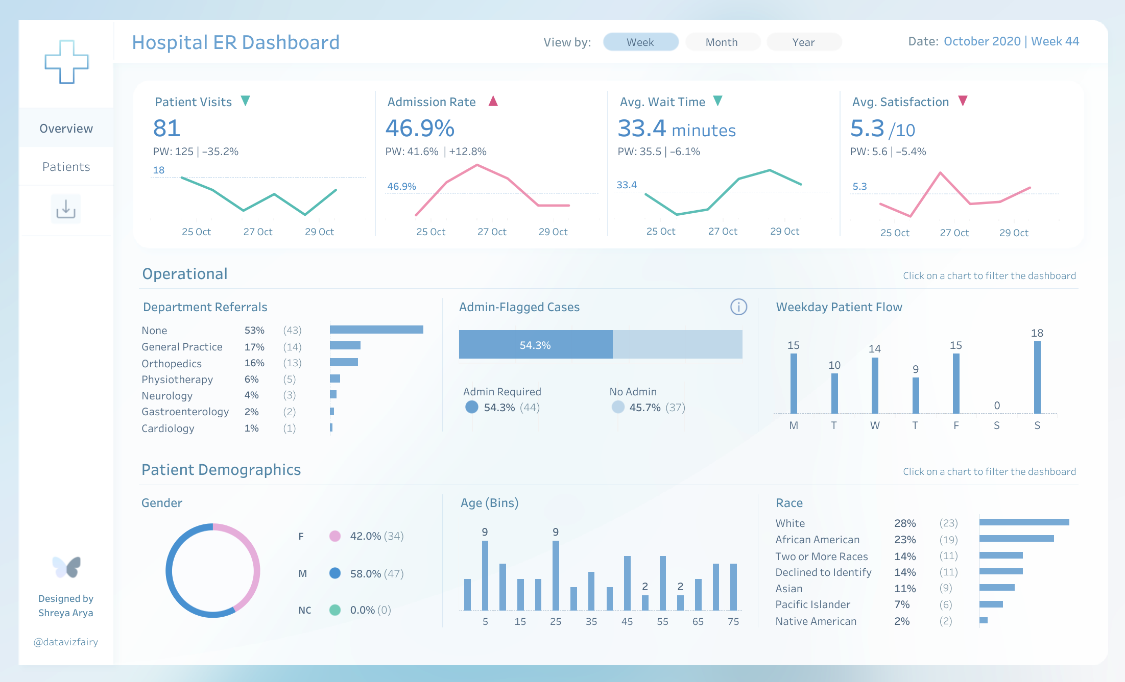
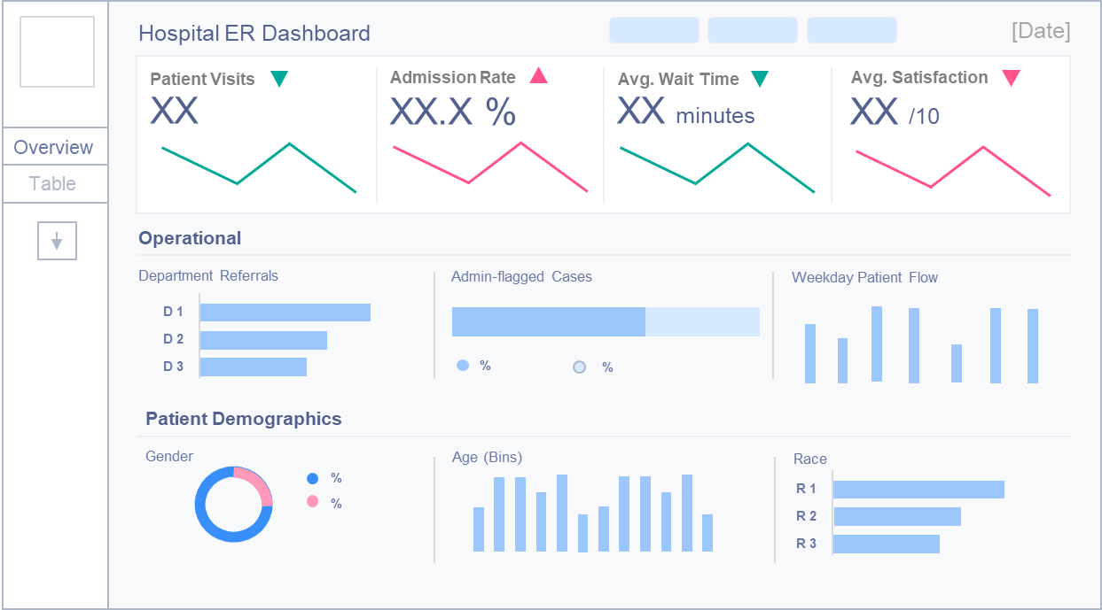
Wireframing
A visual blueprint.
Hospital ER Dashboard | #RWFD by Shreya Arya (Tableau Public)
Notes:
And this is the final product. You can see how the structure remains consistent, but with additional design elements and visual polish added. Wireframing sets the foundation and ensures that the final dashboard flows well and meets user needs.

Slide 41
Why build Wireframes?
4 Reasons why Wireframing is useful…
1. Saves Time
2. Improves Usability
3. Organise Layout
4. Prevent Scope Creep
Notes:
Now, why is wireframing so useful? There are four main reasons:
Saves Time
Planning things out early helps avoid big changes later on. This not only saves time but also cuts down on development costs and effort by reducing back-and-forth adjustments.
Improves Usability
Wireframing helps you test the structure early and gather feedback from users. This ensures the dashboard is easy to navigate and key information is accessible.
Organises Layout
It provides a clear plan for where everything will go, making sure the most important metrics are positioned logically. This helps create a smooth flow of information and avoids confusion.
Prevents Scope Creep
A wireframe helps set clear expectations and allows for early sign-off on the planned dashboard. This ensures everyone is aligned on what’s being built, preventing unnecessary changes or additions later, and keeping the project on track.

Slide 42
Wireframe Foundations
Each wireframe should contain the following information.
 | Element | Description
 | Title | Indicate the dashboard's name or main focus.
 | KPIs & Metrics | Specify key performance indicators or metrics to include.
 | Chart Types | Suggest appropriate chart types for data visualisation.
 | User Interactions | Outline possible interactions (e.g. drill-downs, tooltips).
 | Filters | Define filters available for customising data views.
Notes:
Now that we know how valuable wireframing is, let’s go over the essential elements that form the foundation of any wireframe. These are the key components you’ll need to include:
Title – Indicate the dashboard’s main focus or name to set the context for the user.
KPIs & Metrics – Specify the key performance indicators or metrics that align with the user’s goals and will drive the dashboard.
Chart Types – Suggest the chart types that best visualise the data and highlight the key metrics.
User Interactions – Outline possible interactions, like drill-downs or tooltips, to allow users to explore the data more deeply.
Filters – Define filters that let users customise their data view and focus on the insights most relevant to them.
Including these elements ensures your wireframe is both functional and user-focused, setting the stage for a successful dashboard.

Slide 43
Dashboard Layout
Where to place Key Performance Indicators (KPIs).
1
1
2
2
3
4
3
4
5
Z Pattern
F Pattern
Gutenberg – Visual Scanning
Notes:
Now that we’ve covered the essential elements of a wireframe, let’s look at how we can position those elements, particularly key performance indicators (KPIs). The Gutenberg Principle helps guide us in positioning information based on how users naturally scan a page. The two most common patterns we use are:
Z Pattern – Our eyes move in a Z-shape, starting at the top left, moving across to the right, then diagonally down to the bottom left, and finally across to the bottom right. This pattern creates a smooth, intuitive flow, making it ideal for positioning KPIs.
F Pattern – This pattern follows the way we typically read, starting from the top left, moving across the top, and scanning down in an ‘F’ shape. It’s perfect for layouts with multiple sections of information, helping users focus on key metrics quickly

Slide 44
Dashboard Layout
Where to place Key Performance Indicators (KPIs).
Z Pattern
F Pattern
Stronger Placement!
Notes:
Positioning KPIs at the top is generally the strongest choice in both patterns, as users naturally focus there first. However, another effective option is positioning KPIs along the left-hand side, which also captures the user's attention early in the scan.

Slide 45
Wireframe Fidelity
How closely the wireframe resembles the final product.
Hospital ER Dashboard
Hospital ER Dashboard
Hospital ER Dashboard
Week
Month
Year
KPI 1
KPI 2
KPI 3
KPI 4
Patient Visits
Admission Rate
Wait Time
Patient Satisfaction
Patient Visits
Admission Rate
Avg. Wait Time
Avg. Satisfaction
XX
XX %
XX min
XX /10
XX
XX %
XX min
XX /10
Department
Referrals
BAR
Pie? Percent of total?
Operational
Department 1
Department 2
bar
Department 3
Department 4
Department 5
M
Demographics
Department 1
Department
Referrals
BAR
F
%
Department 2
DONUT
Department 3
%
Department 4
donut
Department 5
Low Fidelity
Medium Fidelity
High Fidelity
Basic, rough sketch
Detailed, functional layout
Polished, near final design
Less detail
More detail
Function & Layout
Style & Design
Notes:
Now that we’ve covered layout and element placement, let’s move on to wireframe fidelity—the level of detail in a wireframe. Depending on the stage of the design process, wireframes can range from low to high fidelity:
Low Fidelity – These are quick, rough sketches used early in the process to explore ideas without focusing on visual details.
Medium Fidelity – These wireframes are more detailed and functional, providing enough information for stakeholder reviews. They allow us to gather feedback and refine the design before moving forward.
High Fidelity – At this stage, the wireframe closely resembles the final product, with polished visuals and detailed functionality. High-fidelity wireframes are used for stakeholder sign-off and testing the visual design.

Slide 46
Wireframe Fidelity
How closely the wireframe resembles the final product.
Hospital ER Dashboard
Hospital ER Dashboard
Hospital ER Dashboard
Week
Month
Year
KPI 1
KPI 2
KPI 3
KPI 4
Patient Visits
Admission Rate
Wait Time
Patient Satisfaction
Patient Visits
Admission Rate
Avg. Wait Time
Avg. Satisfaction
XX
XX %
XX min
XX /10
XX
XX %
XX min
XX /10
Department
Referrals
BAR
Pie? Percent of total?
Operational
Department 1
Department 2
bar
Department 3
Department 4
Department 5
M
Demographics
Department 1
Department
Referrals
BAR
F
%
Department 2
DONUT
Department 3
%
Department 4
donut
Department 5
Low Fidelity
Medium Fidelity
High Fidelity
Fast & Inexpensive
Initial Stakeholder Review
Stakeholder Sign-off
Early in the design process
Refine Ideas
Test Visual Design
Internal
Notes:
Anecdote – How project timelines influence wireframe fidelity: The level of fidelity you present to stakeholders often depends on the project timeline. For example, when I was at the Data School, where we worked on week-long projects, we usually pitched mid-fidelity wireframes. This allowed us to quickly gather feedback and move forward with the build. In contrast, when I was working on longer projects at Lloyds Banking Group, I would pitch high-fidelity wireframes. With more time available, I could ensure everything was polished and aligned before moving on to the next phase.

Slide 47
By Hand or Digital
It depends, who’s your audience?
You
Whatever you’re most comfortable with.
Low Fidelity
Others
Digital – Clearer, more polished, professional.
Low, Medium, High Fidelity
Notes:
Another question I often get asked about wireframes is whether it’s okay to hand-draw them. My answer is, it depends. Who is your audience?
For yourself: If you’re working on early ideas just for you, hand-sketching is great. It’s quick, easy, and perfect for low-fidelity wireframes when you’re brainstorming or working through rough concepts.
For others: But if you're presenting to stakeholders or a team, digital wireframes are usually the better option. They look clearer, more polished, and can range from low to high fidelity depending on your audience’s needs. Plus, they’re easier to share and collaborate on."

Slide 48
Where to Wireframe?
Introducing 3 Digital Wireframing Tools…
Notes:
Now that we’ve covered what wireframing is and why it’s important, let’s talk about where to wireframe. There are plenty of digital tools out there, but today I’ll introduce you to three great options: Excalidraw, PowerPoint, and Figma.

Slide 49
Wireframing Tools:
Excalidraw, PowerPoint & Figma
Excalidraw
PowerPoint
Figma
Quick and simple sketch tool
Great for rough drafts
Highly accessible, as it’s available in most organisations.
Most advanced.
Detailed wireframes and collaborative editing.
Notes:
Let’s dive into each tool:
Excalidraw: A simple, intuitive sketching tool that’s perfect for rough drafts and brainstorming. It’s quick to use, so you can get your ideas down fast without focusing on structure.
PowerPoint: A highly accessible tool, especially since most organisations already use it. PowerPoint is great for creating more structured wireframes, making it a solid choice for presenting early ideas to your team or stakeholders.
Figma: The most advanced of the three. Figma is a powerful platform for detailed wireframes, with collaborative editing as one of its standout features. Multiple people can work on the same design in real-time, making it ideal for team collaboration.

Slide 50
Wireframing Tools:
Excalidraw, PowerPoint & Figma
Excalidraw
PowerPoint
Figma
Low Fidelity
Mid Fidelity
Advanced Fidelity
Quick and simple sketch tool
Great for rough drafts
Highly accessible, as it’s available in most organisations.
Most advanced.
Detailed wireframes and collaborative editing.
Notes:
Excalidraw is perfect for low fidelity—quick, rough sketches in the early stages. PowerPoint suits mid fidelity—structured wireframes that are easy to share and present. Figma excels at high fidelity—detailed wireframes that closely resemble the final product and enable real-time team collaboration.

Slide 51
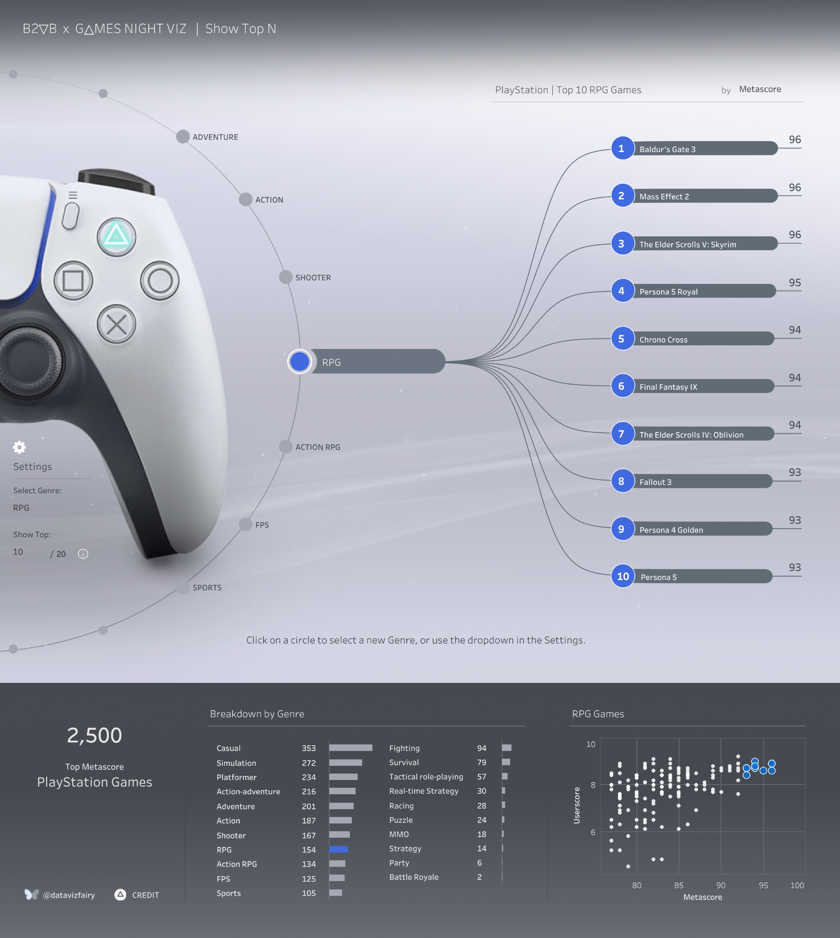
Wireframing Tools:
Excalidraw, PowerPoint & Figma
Demo:
Excalidraw
PowerPoint
Figma
Notes:
So now that we’ve covered these three tools, let’s see how they can be applied. I’ll show you examples of my Top Playstation games viz wireframed in each of these tools, demonstrating their differences in fidelity and functionality.

Slide 52
6 Tips
Take your wireframing game to the next level

Slide 53
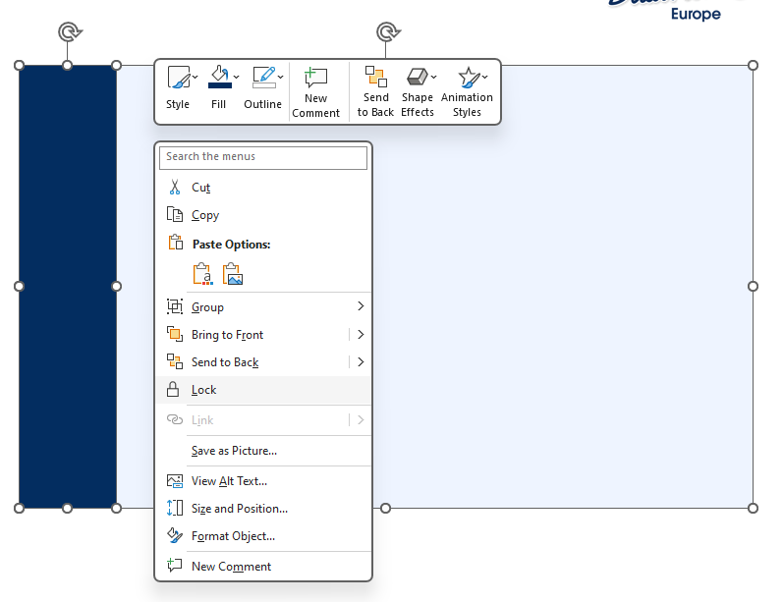
Tip 1.
Lock the base of your dashboard wireframe.
Prevents the base from moving.
Notes:
Hopefully you found that demo interesting! I wanted to

Slide 54
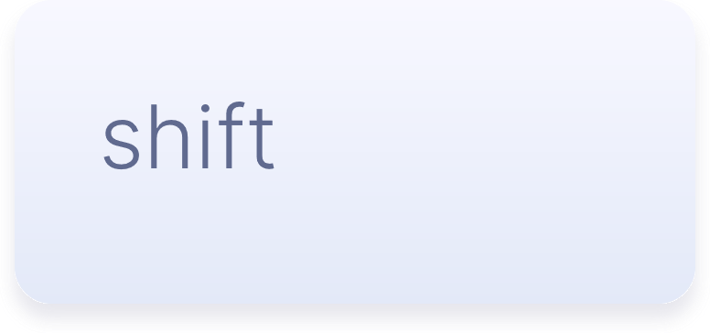
Tip 2.
Hold Shift to draw straight lines.

Slide 55
Tip 3.
Copy and paste chart elements.
Low – Mid Fidelity

Slide 56
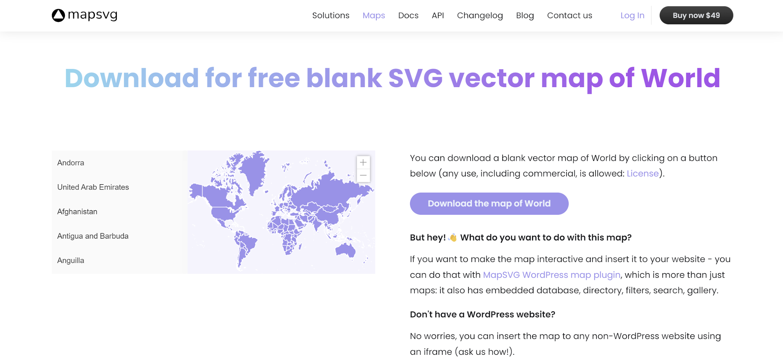
Tip 4.
Need a map?
Use an SVG image:
https://mapsvg.com/maps/world

Slide 57
Tip 4.
Need a map?
Use an SVG image:
https://mapsvg.com/maps/world

Slide 58
Tip 4.
Need a map?
Use an SVG image:
https://mapsvg.com/maps/world

Slide 59
Tip 5.
Logo
Highlight key functionality with comments.
Dashboard Title
Dashboard
Navigation
Buttons

Slide 60
Tip 6.
Be open to feedback!
Your wireframe should be a starting conversation.

Slide 61
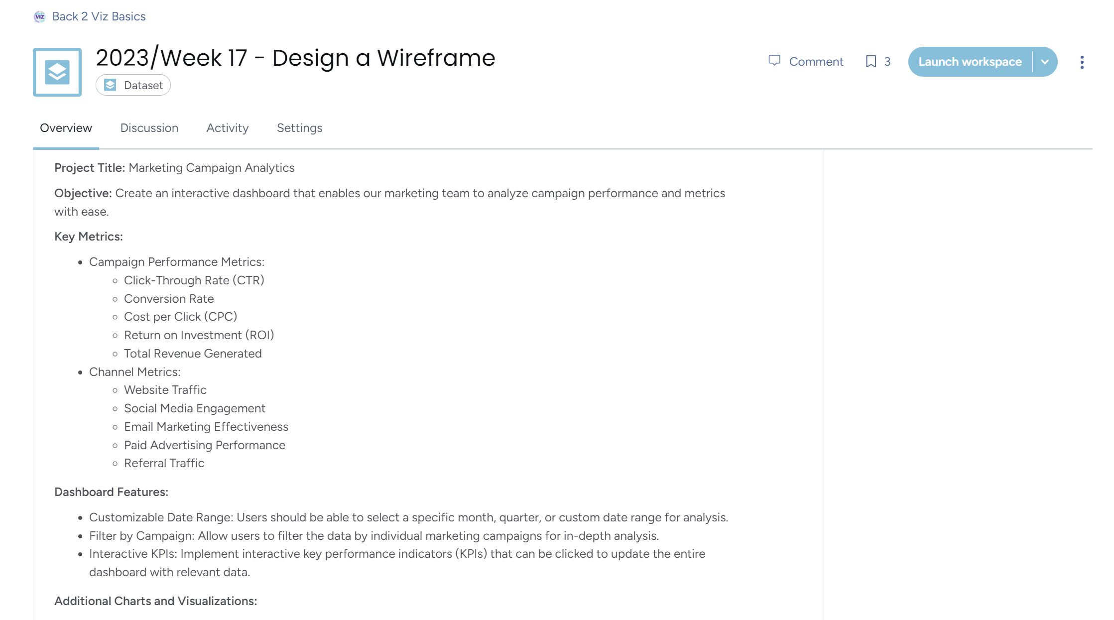
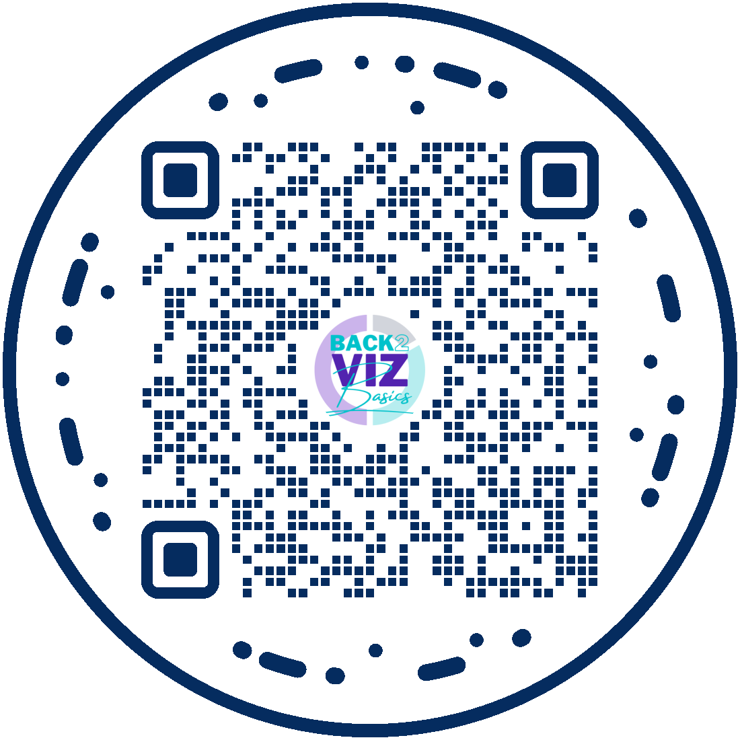
Want to practice?
Week 17, 2023
Design a Wireframe
Try out
Back 2 Viz Basics!
thetableaustudentguide.com/vizbasics
Notes:
With that, If you’d like to practice your wireframing skills, in Exalidraw, Powerpoint or Figma, I invite you to try out Back 2 Viz Basics! For Week 17, 2023, our project released a challenge to design a wireframe for a Marketing Campaign Analytics dashboard, where our prompt acts as you Stakeholder and defines requirements.

Slide 62
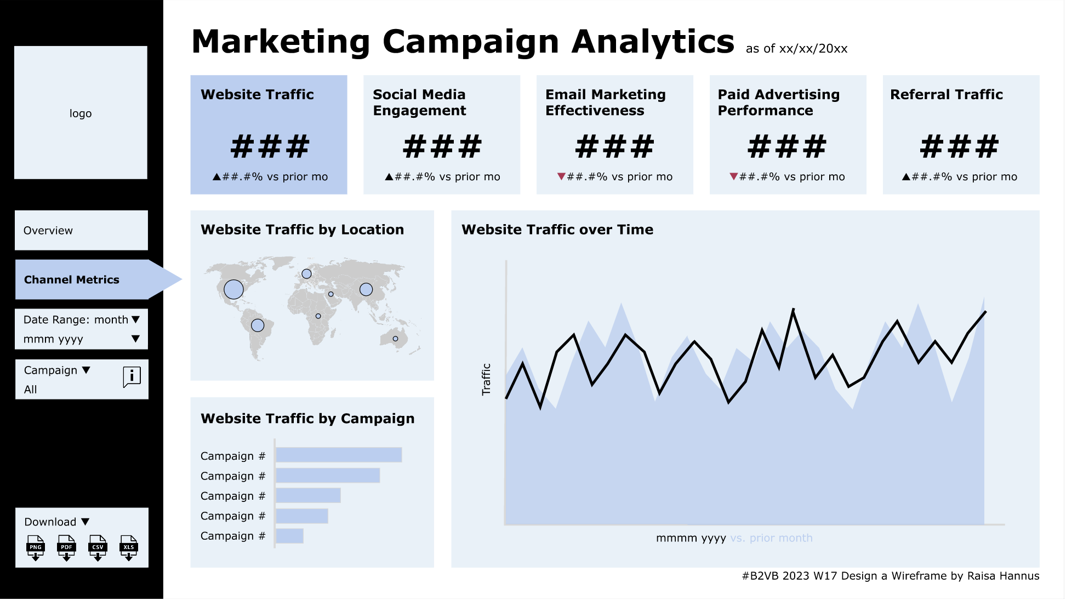
Want to practice?
Week 17, 2023
Design a Wireframe
Try out
Back 2 Viz Basics!
thetableaustudentguide.com/vizbasics
Raisa Hannus
She/Her
Notes:
[Showcase Raisa’s submission made in Figma]

Slide 63
Every Business has its goals...
You can help achieve them with data.
Effective Stakeholder collaboration
Design Thinking
Wireframing
Notes:
So once again, Every business has it’s goals. But now that you have a deeper understanding of Effective stakeholder collaboration, Design Thinking and Wireframing, You can help achieve them with date.

Slide 66
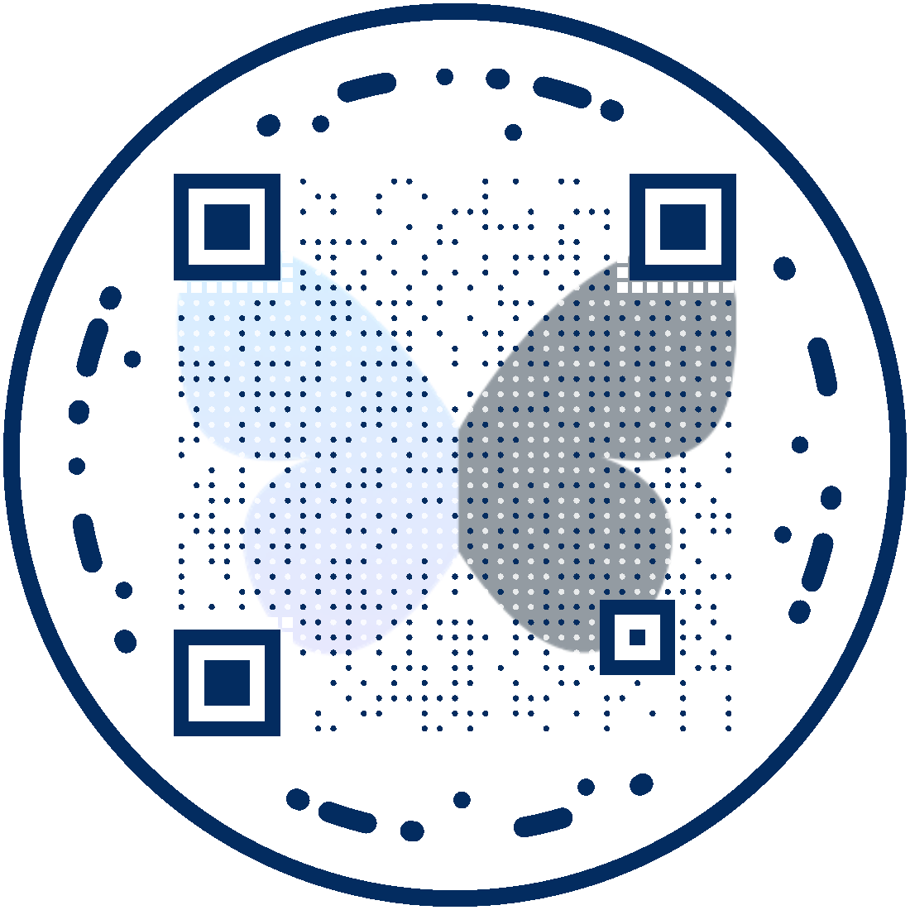
Shreya Arya
Tableau/Alteryx Consultant
@datavizfairy | datavizfairy.co.uk

